Slide 1
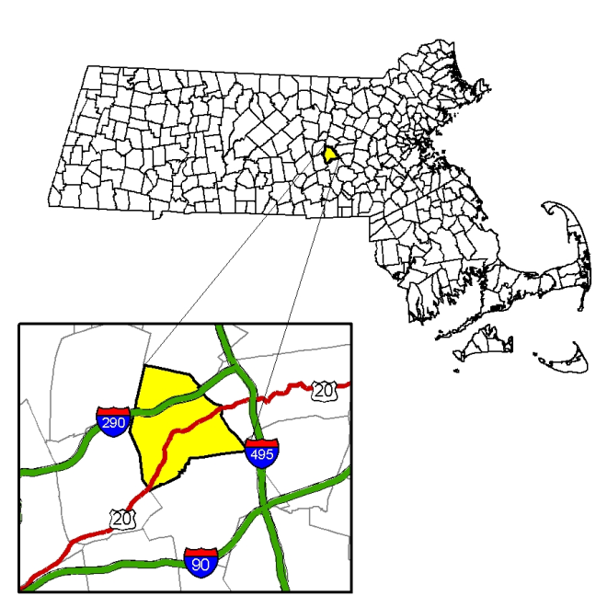
Town of Northborough, MA
Financial Trend Monitoring Report
Fiscal Year 2022
FTM Report covers the period July 1, 2011 (FY2012) through June 30, 2022 (FY2022)

Slide 2
Agenda
Purpose of the meeting is to “set the table” for the FY2023 budget process by:
Reviewing Final FY2021 Budget Results
Providing Status update on the FY2022 Budget
Reviewing Financial Indicators for significant changes
Reviewing Five-Year Financial Projections
Analyzing Multiple-year Projected Tax Impacts
Developing consensus amongst the policy making Boards & Committees about budget assumptions, opportunities and areas of concern
Notes:
Purpose of the meeting is to provide financial context for meaningful policy discussions in FY2022
Since the last meeting, we have closed out FY2020 and started the FY2020 audit; received our certified Free Cash figure; and set the FY2021 tax rate—the base upon which FY2022 planning will start
When discussing 5-yr projections we need to include experience with recent “surprises”, upcoming capital projects, and tax impacts

Slide 3
FY2021 Recap
April 27, 2020 Town Meeting delayed until July 18, 2020
FY2020 close out and audit delayed; Free Cash Certified at $1.98
Final State FY2021 Budget delayed from July 1, 2020 to December 2020; Governor & Legislature committed to level State Aid in fall of 2020
Final Town FY2021 Budget and tax rate approved November 23, 2020 using level State Aid estimate resulting in average Single Family Home tax bill reduction of $65
Free Cash at fiscal year-end on June 30, 2021 estimated at $3,406,894 (pending DOR certification)
Notes:
Purpose of the meeting is to provide financial context for meaningful policy discussions in FY2023
Since the last meeting, we have closed out FY2021 and started the FY2021 audit; estimated our Free Cash figure; and set the FY2022 tax rate—the base upon which FY2023 planning will start
When discussing 5-yr projections we need to include experience with recent “surprises”, upcoming capital projects, and tax impacts

Slide 4
FY2021 Year-end Revenues
Notes:
Will still take a couple of years for revenues to fully recover, especially local receipts

Slide 5
FY2021 Year-end Expenditures
Notes:
Note Appropriations Reserve Account increased by $200,000 to $375,000 in FY2021 to potential mitigate unknown COVID expenses, but we only used $45,000 due to mild winter and Federal COVID assistance, so it closed out to free cash

Slide 6
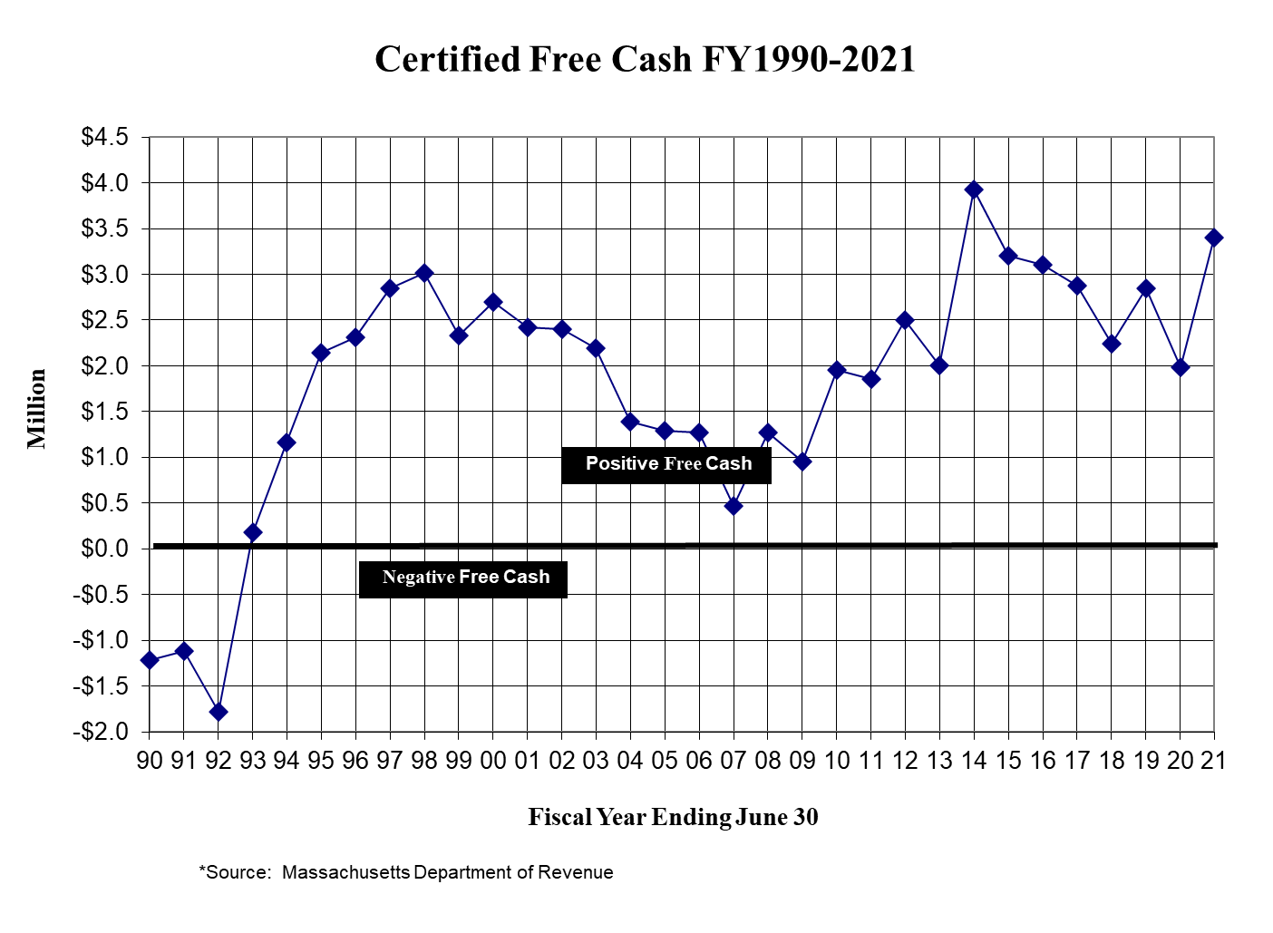
Notes:
Note State Revenues and budget surplus followed similar pattern due to recovering economy and success of vaccinations
30+ average FC $1.8 M
10 Year average $2.81M

Slide 7
FY2022 Status Update
May 1, 2021 Town Meeting on time
FY2021 close out and audit delayed due to Federal Aid & Grants
Final State FY2022 Budget signed July 16, 2021 resulting in $5.56 million (net $12,914 above budget after assessments)
Final Town FY2022 Budget and tax rate approved November 22, 2021 resulting in average Single Family Home tax bill increase of $295
Federal & State Assistance impacts on FY2022 and FY2023 still being defined

Slide 8
$4.5 Million Federal American Rescue Plan Act (ARPA)
$1.85 Trillion Federal Build Back Better Act
Pending
$4 Billion State COVID Recovery Bill
Northborough Priorities
Budget Processes
Financial Policies
FTMS & Forecasts
6-Year Capital Plan
Master Plan
Services & Staffing
COVID Response
Sustainability
$1.2 Trillion Federal Infrastructure Investment & Jobs Act
State FY2022-23 Revenue Outlook
FEMA Emergency COVID Reimbursement Extended to 4/1/22
State ARPA Funding
FY2023 Budget
Notes:
President Biden extended through April 1, 2022, 100% federal reimbursement through the Federal Emergency Management Agency’s Public Assistance Program for eligible costs associated with ongoing COVID-19 recovery efforts and vaccine initiatives. The policy was set to expire Dec. 31.

Slide 9
Pandemic Budget Reductions
Cut Operating Budgets to 1% in FY2021 and constrained increases in FY2022
Used $378,000 in one-time Free Cash in the FY2021 Budget
Cut $200,000 in Stabilization Fund Contributions in both FY2021 & FY2022
Postponed Capital Investments in FY2021 and had less Free Cash to fund pay-as-you-go projects in FY2022 (those postponed needs have not gone away!)
Cut over $1 million in contributions to Other Post Employment Benefits Trust Fund (OPEB)
Northborough’s fiscal policies and conservative planning enabled us to successfully navigate the pandemic response while maintaining core service levels
Priority should be restoration of the temporary cuts and postponed capital projects

Slide 10
What is Financial Condition?
Financial condition is broadly defined as the ability of a Town to:
Maintain existing service levels,
Withstand local and regional economic disruptions, and
Meet the demands of natural growth, decline, and change.
**The FTMS Report is designed to objectively measure Financial Condition**
Notes:
We talk about sustainability in general terms during the budget process but what, specifically are we measuring to know we are achieving it?

Slide 11
Aspects of Financial Condition
Cash Solvency: The Town’s ability to pay immediate obligations during the next 30-60 days
Budgetary Solvency: Its ability to pay financial obligations within the current fiscal period (balanced Fiscal Year)
Long-Run Solvency: Its ability to continue paying obligations in future fiscal periods (debt, pensions, etc.)
Service-Level Solvency: The Town’s ability to continue providing the level of services expected by its residents
Notes:
A Town lacking service-level solvency might in all other respects be in sound financial condition, but be unable to support critical services at an adequate level. In a financial crisis situation, trying to maintain service-level solvency might result in a municipality experiencing cash, budgetary, or long-run solvency problems. That is why it is important to view the concept of financial condition from all four perspectives.

Slide 12
Financial Trend Monitoring System
Key financial indicators are analyzed in order to assess the financial direction of the Town. Many of the same benchmarks used by the credit rating industry.
The full report is designed to bring issues and opportunities to the attention of decision-makers through a systematic method of trend analysis.
Report developed using the ICMA manual entitled Evaluating Financial Condition, A Handbook for Local Government.
Notes:
If the bond rating agencies are tracking and reporting this information, shouldn’t we?
The ICMA handbook is the universal gold standard for FTM used by communities across the nation.

Slide 13
Purpose of the FTMS
Gain understanding of the Town’s financial condition
Identify hidden or emerging problems before they reach serious proportions
Present a straightforward picture of strengths and weaknesses to Town Officials and citizens
Reinforce the need for long-range considerations in the budget process
Provide a starting place for reviewing and updating financial policies that guide decision-making

Slide 14
Objectives of the FTMS
Predict: so that the Town can be prepared to deal with fiscal distress before it becomes fiscal crisis
Avert: and take action to avoid fiscal crisis
Mitigate: through corrective action and/or policy changes, regain sound financial footing, or at least contain the problem
Prevent: a recurrence of fiscal distress after the Town addresses the current issue or crisis (e.g., reliance on one-time revenues or health insurance increases)

Slide 15
Fiscal Distress vs. Fiscal Crisis
Fiscal Distress: temporary imbalance between the level of financial resources the Town has committed and its potential available resources
Fiscal Crisis: occurs when the local government can no longer pay its bills or provide existing levels of service
Goal is to protect our policy-making ability by ensuring that important decisions are not controlled by financial problems or emergencies.
Notes:
Although unforeseen events can sometimes create a fiscal crisis, the signs of fiscal distress are often revealed in several recurring indicators. These include structural, economic, demographic and institutional factors.

Slide 16
Executive Summary
 | Financial Indicator | FY2022
1 | Property Tax Revenues | Favorable
2 | Uncollected Property Taxes | Favorable
3 | Revenues & Expenditures per Capita | Favorable
4 | State Aid (Intergovernmental Revenues) | Unfavorable
5 | Economic Growth Revenues | Unfavorable / Uncertain
6 | Use of One-Time Revenues | Favorable
7 | Personnel Costs | Stable
8 | Employee Benefits | Stable / Uncertain
9 | Pension Liability | Unfavorable
10 | Other Post Employment (OPEB) Liability | Unfavorable / Improving
11 | Debt Service Expenditures | Favorable
12 | Financial Reserves/Fund Balance | Favorable
13 14 | Capital Investment—Overall fixed asset values Capital Investment—Pavement Management | Pending Audit Stable

Slide 17
Executive Summary
 | Financial Indicator | FY2022
1 | Property Tax Revenues | Favorable
2 | Uncollected Property Taxes | Favorable
3 | Revenues & Expenditures per Capita | Favorable
4 | State Aid (Intergovernmental Revenues) | Unfavorable
5 | Economic Growth Revenues | Unfavorable / Uncertain
6 | Use of One-Time Revenues | Favorable
7 | Personnel Costs | Stable
8 | Employee Benefits | Stable / Uncertain
9 | Pension Liability | Unfavorable
10 | Other Post Employment (OPEB) Liability | Unfavorable / Improving
11 | Debt Service Expenditures | Favorable
12 | Financial Reserves/Fund Balance | Favorable
13 14 | Capital Investment—Overall fixed asset values Capital Investment—Pavement Management | Pending Audit Stable

Slide 18
Town of Northborough Financial Indicators
Indicator 1: Property Tax Revenue
Formula: Property Tax Revenues in constant dollars
Warning: Declining tax revenues
Trend: Favorable
Comments: Taxes represent approximately 80% of the Town’s revenue, growth has exceeded the rate of inflation by 0.3% to 5.7% annually, depending on amounts of new growth, operational overrides and remaining unused levy capacity
Notes:
The analysis shows that property tax revenue adjusted to constant dollars is positive and therefore has kept pace with inflation. Further, the Town’s revenue growth has occurred with minimal operating Proposition 2 ½ overrides.
Overrides were approved to provide additional funding for public schools of $487,370 in FY2003, $362,734 in FY2007 and $316,047 in FY2009.
The other years that had property tax revenue increases over the Proposition 2.5% limit, used excess levy capacity from the preceding year to increase the tax levy. This excess levy capacity was generated from conservative budget estimates of new growth.

Slide 19
Town of Northborough Financial Indicators
Indicator 2: Uncollected Property Tax Revenue
Formula: Uncollected Property Taxes as % of Net Tax Levy
Warning: Increasing uncollected property taxes
Trend: Favorable
Comments: Collection rates below 95% are considered negative by bond rating agencies; Northborough’s collection rates are consistently between 98-99%
Notes:
The lower figure for current year collections reflect local option relief legislation adopted by the Town last year, which limited the Town’s collection activities through June 2020. Collection resumed in July, and therefore the Town would have shown similar performance with prior years given the subsequent months activities.

Slide 20
Town of Northborough Financial Indicators
Indicator 3: Revenues & Expenditures per Capita
Formula: Revenues & Expenditures divided by population
Warning: Expenditures per capita in excess of revenues per capita
Trend: Favorable
Comments: Since FY10 revenues per capita have exceeded expenditures per capita, although the gap fluctuates based upon economic conditions.
Notes:
From FY2003 through FY2008, expenditures per capita exceeded revenues per capita due to the use of one-time funds in the operating budget, mainly from Free Cash.
With a significant reduction in the Free Cash available for the FY2009 operating budget (From close of FY2007), the need for a policy revision was apparent.
With the subsequent adoption of the Free Cash Policy in November 2010, the use of one-time revenue for the operating budget was phased down and capped at $500,000, with an additional $150,000 used for the Appropriations Committee Reserve Fund. Therefore from FY2010 forward, the Town’s revenues per capita exceed expenditures per capita. The funds represented by the difference are now closed to surplus and are then available to fund capital items and other one-time expenditures in accordance with the Free Cash Policy.

Slide 21
Notes:
Get from budget reference/state aid

Slide 22
Town of Northborough Financial Indicators
Indicator 4: State Aid (Intergovernmental Revenues)
Formula: State Aid as a percentage of operating revenues
Warning: Significant increase or decrease as % operating revenues
Trend: Unfavorable
Comments: State Aid went from a high of 13.1% of revenues in FY03 to 8.4% in FY22. Future aid remains uncertain given the ongoing impacts of the COVID-19 pandemic on the economy.
Notes:
The level of State Aid provided to municipalities is a continuing concern in Massachusetts. State mandates are imposed on already strained municipal budgets with no corresponding funding. State Aid to Northborough generally represents approximately 10% of total municipal revenue with the exception of FY2003 when State Aid represented 13.1% of revenue. Northborough’s State Aid has yet to be restored to the peak levels reached in FY2003, especially when controlling for inflation (constant dollars).
Due to the uncertainty in the level of State Aid provided from year to year, this represents an unfavorable trend with an uncertain outlook for the Town of Northborough. The potential for the Commonwealth to cut State Aid requires the Town to carefully monitor these revenues, and to have contingency plans if State Aid were reduced.
Town received a mid-year cut in State aid of 1% during FY2013

Slide 23
FY2023 State Aid Forecasts
On December 3, 2021 Department of Revenue announced that tax collections for the first 5 months of FY2022 totaled 18.7% above collections through the same period a year ago.
Thus far, FY2022 State tax collections have surpassed budget benchmarks by 7.2%
State Revenue Consensus Hearing on December 21, 2021
Governor’s FY2023 Budget is scheduled to be released January 26th
Assuming FY2023 State Aid will increase 1% based upon trends
Any State Aid received above the Town’s estimate can only be used to reduce taxes
State Aid is a political process and not a math exercise

Slide 24
Town of Northborough Financial Indicators
Indicator 5: Economic Growth Revenues
Formula: Economic Growth Revenues divided by net revenues
Warning: Decreasing Economic Growth Revenues as % revenues
Trend: Unfavorable / Uncertain
Comments: Economic Growth Revenues went from stable to unfavorable overnight with the impacts of the COVID-19 pandemic. This indicator has seen recent improvement but will require close monitoring over the balance FY2022 as more financial and economic data becomes available. As Town approaches buildout new growth & permits likely to decline.
Notes:
Revenues related to economic growth (elastic revenue sources) include tax levy growth from new development, motor vehicle excise taxes, as well as building permits and construction related permit fees. These revenues are sensitive to changes in the level of economic activity. A decrease in new economic development and building permit fees may be a leading indicator of smaller future increases in the tax levy.
Northborough’s revenues from economic growth have increased since FY2009 despite a weak State and national economy. An important factor has been the construction of a 382 unit apartment complex known as Avalon Bay beginning in FY2010 and the recent completion of the 640,000 square foot Northborough Crossing Shopping Center in FY2013. Although the past several years have seen a positive trend in Northborough’s economic revenues, future growth is uncertain as these major projects are now completed and there are fewer significant developments currently in the permitting stage. Looking forward, the Town’s future revenue from economic growth remains uncertain.

Slide 25
FY2023 Local Receipts
FY2022 Local Receipts were budgeted to increase 8% to $4.2M
FY2023 Local Receipts forecasted at level funding:
Anticipated Meal taxes lowered from original estimate
One of Northborough’s two hotels is offline with no anticipated return date
Motor Vehicle Excise will not be known until receipt of major commitment in February. Supply chain disruptions and computer chip shortages are of concern looking forward
Building Permits were above target last year due to a large project fee; however, no large projects are anticipated

Slide 26
Town of Northborough Financial Indicators
Indicator 6: One-Time Revenues
One Time Revenues as a % of Expenditure Budget
Formula: One-Time Revenues as % of Operating Budget
Warning: Increasing amount of one-time revenues in the budget
Trend: Favorable
Comments: Free Cash Policy reduced reliance on one-time revenues from a high of $1.5 million (4.1%) in FY05 to $500,000 (.8%) in FY22 Free Cash was diverted to finance $12.86 million pay-as-you-go capital investments since FY12. In FY21 an additional $378,000 in Free Cash was used to mitigate the impacts of COVID-19.
Notes:
Northborough’s use of one-time revenue to fund the operating budget was significantly curtailed during the past several years. The Free Cash policy adopted in 2010 limited the use of Free Cash to one-time expenditures with a limited amount to be used toward the operating budget. Any additional Free Cash above this level is used to fund one-time capital expenditures, or for emergency spending. One-time revenue in the operating budget has declined from a high of $1.5 million or 4.3% in FY2005 to $650,000 or 1.4% in FY2013, where it will remain stable in accordance with the Free Cash policy.

Slide 27
Town of Northborough Financial Indicators
Indicator 7: Personnel Costs
Formula: Personnel expenses as % of Budget
Warning: Salaries & wages increasing as % of expenditures
Trend: Stable
Comments: Personnel wages & benefits represent approximately 76% of the Town’s operating budget net of ARHS & Assabet school assessments and remain relatively stable due to health insurance benefit changes, sustainable staffing and wage increases
Notes:
Increasing salaries and wages as a percent of operating expenditures may be an indicator of two trends: first, it may point to future pension and health insurance costs since both of these items are related to the number and compensation level of employees; second, if salaries and wages as a percent of operating expenditures are increasing, it may be an indicator that the Town is not adequately funding its capital needs or of deferred maintenance of the Town's infrastructure.
Overall, personnel wages and benefits represent approximately 60% of the Town’s operating budget and remains relatively stable. Although health insurance prior to FY2009 was increasing at double-digit rates annually, the Town has been able to mitigate these increases since FY2009 though negotiated plan design changes with the employees. More detail regarding the plan design changes is explained under Indicator #8.
Wages, salaries and employee benefits as a percentage of operating expenditures increased 2.7% from FY2007 to FY2012. The largest increase was in salaries and wages with an increase of 1.9%, employee benefits accounted for only 0.3% and increases in the amount of the annual retirement assessment were 0.6% of the increase. In recent years many municipalities have experienced a dramatic increase in health insurance obligations. This expenditure trend, although increasing, represents a stable rate of growth. Looking forward, the rate of growth is contingent upon negotiating future collective bargaining agreements that are sustainable, as well as balancing the addition of any new staff with new, recurring revenue sources.

Slide 28
Town of Northborough Financial Indicators
Indicator 8: Employee Benefits
Formula: Employee benefit costs as % of salaries & wages
Warning: Increasing employee benefits as % of salaries & wages
Trend: Stable / Uncertain
Comments: Overall, employee benefits as a % of wages & salaries increased 2.9% from FY12-FY21. FY15 includes the first annual $500k transfer to the OPEB trust fund. Due to economic impacts of the pandemic Trust Fund contributions were postponed in FY2021 and again FY2022. The retirement assessment is increasing to address unfunded pension liability by 2036.
Notes:
Overall, employee benefits as a percentage of wages and salaries has increased less than 1% from FY2007 through FY2012. However, the retirement assessment has consistently increased from 4.0% in FY2007 to 5.2% in FY2012. In analyzing the employee benefits alone, which are primarily composed of the cost of health insurance, employee benefits increased to a peak of 22.9% in FY2010. Plan design changes to health insurance that were implemented in FY2010 have halted that increasing trend and employee benefits have now decreased to 20.2 % of wages and salaries in FY2012. It should be noted that if health insurance premiums begin increasing again at 10-15% annually, there will be significant impacts on future operating budgets for all departments.
The FY2013 health insurance budget of $4.66 million represents a total increase of just $150,847, or 3.34%, from the amount budgeted last year. While the premiums for some individual health insurance plans may increase, plan design changes and the adoption of Chapter 32B, Section 18 in FY2010 have helped limit budgetary increases again in FY2013. In addition, the Town worked closely with the School Department to increase teacher contributions during FY2012 from 20% to 25% for Health Insurance. Given the reasonable FY2013 premium increases, there are no immediate plans to further modify health insurance plans during FY2013.

Slide 29
FY2023 Health Insurance
FY2010 Plan Design Changes and adoption
of MGL c.32B, Section 18
FY2012 Teacher contributions increased 5%
FY2017 Plan Design Changes
FY2018 Plan Design Changes but still
experienced an 8.33% increase
FY2019 Negotiated Carrier Consolidation
resulted in a 3.8% budget increase
FY2023 Out to bid following Fallon’s exit from
the commercial market

Slide 30
FY2023 Health Insurance
Why is the Health Insurance budget increase so critical?
10% increase on $6.12 million health budget is $612,000
3% increase on the Total General Government Budget is approximately $709,000
Health Insurance would consume 86% of all new FY2023 revenues for non-school departments. It swamps all other budget considerations.
Town is investigating a joint procurement with ARHS and Southborough as part of the FY2023 Health Insurance bid process

Slide 31
Town of Northborough Financial Indicators
Indicator 9: Pension Liability
Formula: Pension Assets divided by Pension Liabilities
Warning: Unfunded liability or increase in unfunded liability
Trend: Unfavorable
Comments: Northborough is part of Worcester Regional Retirement System which is on schedule to be fully funded by 2036—four years before the 2040 deadline; the new funding schedule, recent pension reform and improving economy are all forces for future improvement. Northborough’s current unfunded liability is $33M.

Slide 32
Town of Northborough Financial Indicators
Indicator 10: Other Post-Employment Benefits
Reporting Period | FY2009 | FY2009 | FY2011 | FY2013 | FY2015 | FY2016 | FY2017 | FY2018 | FY2019 | FY2020 | FY2021
In Millions | Original | Revised
Total OPEB Liability | $90.44 | $34.29 | $28.07 | $32.64 | $35.38 | $36.57 | $39.14 | $47.33 | $37.75 | $40.05 | $45.94
Actuarial Value of Assets | - | - | - | - | $0.50 | $1.05 | $1.73 | $2.44 | $3.11 | $3.74 | $4.83
Net OPEB Liability | $90.44 | $34.29 | $28.07 | $32.64 | $34.88 | $35.52 | $37.41 | $44.89 | $34.64 | $36.32 | $41.11
Discount Rate | 4.00% | 4.00% | 4.00% | 4.00% | 4.00% | 4.00% | 6.00% | 5.25% | 6.25% | 6.25% | 6.25%
Funded Ratio | 0.00% | 0.00% | 0.00% | 0.00% | 1.43% | 2.87% | 4.43% | 5.15% | 8.25% | 9.33% | 10.52%
Formula: Other Post-Employment Assets divided by Liabilities
Warning: Unfunded liability or increase in unfunded liability
Trend: Unfavorable / Improving
Comments: $500K in planned annual contributions to the OPEB Trust Fund beginning in FY15 started to improve the Town’s funding ratio. As of 10/31/2021 the Fund has $5.1M. Positive investment income marginally improved the funding ratio despite pandemic impacts preventing financial contributions in FY2021 & FY2022. Reinstatement of annual contributions should be a priority in FY2023 and beyond.
Notes:
No contributions in FY21, value as of 10/31/2021 is $5,077,132.32
$3,050,000 contributions LTD, $2,027,132 are investment earnings

Slide 33
Town of Northborough Financial Indicators
Indicator 11: Debt Service
Formula: Debt Service as % of General Fund Expenditures
Warning: Increasing debt service as % of operating expenditures
Trend: Favorable
Comments: Overall, the Town’s level of debt service is within the 5% to 10% suggested by the debt policy and represents an appropriate level of capital investment. FY16 & FY17 included $14.2 million in debt for the Lincoln St. School building project. The Town remains well positioned to finance the upcoming Fire Station building project.
Notes:
The total debt service for Northborough is comprised of both the general obligation bonds of the Town as well as the overlapping debt associated with the Northborough’s share for the Algonquin Regional High School (ARHS). Once permanent bonds are issued, these fixed expenses are mandatory. Therefore, significant levels of debt service can serve to limit flexibility in funding operating budgets. The Town’s Debt Policy provides that the Town will endeavor to manage debt so as not to exceed a ratio of 5% to 10% of the net general fund debt service to total general fund expenditures. Since FY2003, our levels of debt service are well within this range with the exception of FY2004. That was the first year of the $10 Million, 10-year bond issued for the ARHS Building Project with the debt structured with a significant $1,850,000 principal payment in the first year.
Overall, the Town’s level of debt service is within the 5% to 10% suggested by the debt policy and represents an appropriate level of capital investment in infrastructure. The credit rating agency, Moody’s Investors Service indicated in a recent review that the Town’s “overall debt burden will remain manageable” and noted that the principal amortization of 71.4% within 10 years was favorable. The trend is downward with future debt service expected to decrease from the 6.97% level in FY2013 as the $10 Million ARHS Building project bond will be fully satisfied in FY2013.

Slide 34
Town of Northborough Financial Indicators
Indicator 12: Reserves/Fund Balance
Formula: Financial Reserves as % of operating revenues
Warning: Declining reserves as % of operating revenues
Trend: Favorable
Comments: Northborough’s financial policy provides for reserves to average between 5% and 10% of the Town’s General Fund (Operating Budget) expenditures. FY15-FY20 included $200K in annual contributions to the Stabilization fund; however, no contributions were made in FY21 or FY22 due to the pandemic. Reinstatement of annual contributions will be necessary to maintain ratios as budgets increase.

Slide 35
Town of Northborough Financial Indicators
Indicator 14: Capital Investment–Pavement Management
Formula: Average Road Surface Rating (RSR, formerly PCI)
Warning: Declining overall average RSR
Trend: Stable
Comments: The minimum annual investment needed to maintain the current average RSR is $1.1 million. The target was met in FY20 with $300K in the operating budget, $300K in the capital plan, and $518K in State Chapter 90 Funds. The RSR improved from 71 to 73.9 over the last five years but reduced in FY20 due to needed culvert work. The RSR rating is being updated for FY2021 and is expected to remain stable, but without increased investment will decline in the future.

Slide 36
Executive Summary
 | Financial Indicator | FY2022
1 | Property Tax Revenues | Favorable
2 | Uncollected Property Taxes | Favorable
3 | Revenues & Expenditures per Capita | Favorable
4 | State Aid (Intergovernmental Revenues) | Unfavorable
5 | Economic Growth Revenues | Unfavorable / Uncertain
6 | Use of One-Time Revenues | Favorable
7 | Personnel Costs | Stable
8 | Employee Benefits | Stable / Uncertain
9 | Pension Liability | Unfavorable
10 | Other Post Employment (OPEB) Liability | Unfavorable / Improving
11 | Debt Service Expenditures | Favorable
12 | Financial Reserves/Fund Balance | Favorable
13 14 | Capital Investment—Overall fixed asset values Capital Investment—Pavement Management | Pending Audit Stable

Slide 37
FTMS Summary
Current Financial Condition
Northborough is still in relatively good financial condition
Tax base is strong with good diversification
Financial Reserves are healthy at 9%
Debt service is manageable at less than 5% of operating budget with preferred Aa1 bond rating
Reliance on one-time revenues in the operating budget is back down to the policy target of $500,000, or approximately 1% (FY2021 used an additional $378,000)
Capital investments were strong leading up to pandemic which allowed for temporary project postponements

Slide 38
FTMS Summary
Potential Emerging Concerns
Postponement of OPEB funding in FY21 and FY22 requires reassessment of future investment plans in FY23
Postponement of capital investments in FY21 and FY22 must be addressed beginning in the FY23 Capital Improvement Plan
Postponement of Stabilization Fund contributions (rainy day fund) in FY21 and FY22, requires reassessment
Uncertainty surrounding future levels of State Aid and Federal Assistance
Uncertainty surrounding Local Receipts and economic recovery following vaccinations
Reduced future economic development (new growth) revenues as Town approaches buildout

Slide 39
FY2023 Budget Assumptions
Tax increase includes $300K excess levy capacity for OPEB
State Aid increases 1% over FY2022 Actual
Local Receipts level funded
No additional Free Cash in the operating budget beyond $500K policy limit
$500K contribution to OPEB Trust Fund (taxes and ARPA)
$200K Stabilization Fund contribution from Free Cash
General Government increases 3.39%
K-8 Schools increase 3.39%
ARHS Assessment increases 3.39%
All decisions must be made while maintaining compliance with the Town’s adopted Comprehensive Financial Policies (Appendix A of the Budget)
Notes:
Our overall budget across all departments is 75% personnel
Goal is to recruit and retain qualified employees
We’ll spend some time talking about the OPEB issue and our options for addressing this single, most important issue facing our financial condition.

Slide 40
Financial Projections
Overview
Five-Year Projections
Assumptions Used for Projections
Future Tax Impact
Financial Outlook

Slide 41
Financial Projections
Methodology
Revenue driven model
Based upon the existing revenue sharing model
Establishes a revenue ceiling based upon Proposition 2 ½ and backs into the allowable annual budget growth
Uses FY2022 as the base and looks out 5 years
Focuses on the top three revenue sources, or 95%
Taxes 82%, State Aid 8%, Motor Vehicle Excise 5%)
Minimum goal is to maintain level service budget
Can we protect and maintain what we have now?
Will we be able to address future wants and needs?
Notes:
The methodology relies on projections regarding available revenue, thereby accepting the limits of the Town's financial resources. The budget is based upon an established ceiling of revenue derived from local property taxes in accordance with Proposition 2½. Added to these revenues are State Aid, Departmental Receipts such as fees, permits, interest earned and Available Funds such as Free Cash and Special Revenues.

Slide 42
Financial Projections
Assumptions
Taxes increase by allowable Proposition 2 ½
New growth $40 million in value ($660K in new taxes) for FY2023, $30 million from FY2024-FY2027
Existing unused levy capacity is available for use
State Aid increases 1% annually
MVE and other local receipts, projected to return to FY2020 levels by FY2025, level through FY2027
Adhere to adopted Financial Policies
No one-time revenue gimmicks
Maintain financial reserves
Continue to invest in Capital Improvement Plan (CIP)
Notes:
The methodology relies on projections regarding available revenue, thereby accepting the limits of the Town's financial resources. The budget is based upon an established ceiling of revenue derived from local property taxes in accordance with Proposition 2½. Added to these revenues are State Aid, Departmental Receipts such as fees, permits, interest earned and Available Funds such as Free Cash and Special Revenues.

Slide 43
Financial Projections
Assumptions (con’t)
OPEB funding returned to budget in FY2023 at $500,000 and assumes $550,000-$600,000 annually from FY2024-FY2027
Debt service for major capital projects included
Fire Station Project (Debt Exclusion)
Key budget increases
NB K-8 Schools & General Government 3.39% for FY2023, then 3.5% annually
ARHS Assessments 3.39% for FY2023 , then 3.5% annually
Assabet 5% increase FY2023, then 3.5% annually
Attempt is to maintain level services

Slide 44
Five-Year Expense Projections

Slide 45
Five-Year Revenue Projections

Slide 46
Projected Tax Impact

Slide 47
Historic & Projected Tax Bills

Slide 48
Financial Projections
Financial Outlook
Budgets increase minimally to maintain services
No significant staffing or service level increases
Existing $4.3M unused levy capacity drawn down to maintain level services
Taxes increase between 3.7% to 6.8% annually
FY2021 was revaluation year, market adjustments to property values continue to increase annually
FY2023 assumes 10% increase in single family home valuations
Assumes no major budget “surprises”

Slide 49
Conclusion
Postponement of OPEB funding will require reassessment of future investment plans
Postponement of capital investments will require reassessment of future Capital Improvement Plans
Continue to monitor Health Insurance costs
Continue evaluating the COVID-19 recovery and its economic impacts
Continue assessing our Financial Condition, work collaboratively to address Town-wide issues, and strive to balance departmental needs with the impact on the taxpayer

Slide 50
Financial Trend Monitoring Report
QUESTIONS?
FTM Report covers the period July 1, 2011 (FY2012) through June 30, 2022 (FY2022)

